Slide 1

Final Year Project Seminar Machine Learning for Defect Detection in 3D Printing Process
Boon Ho
Supervisor: Dr. Paul Hooper

Slide 2
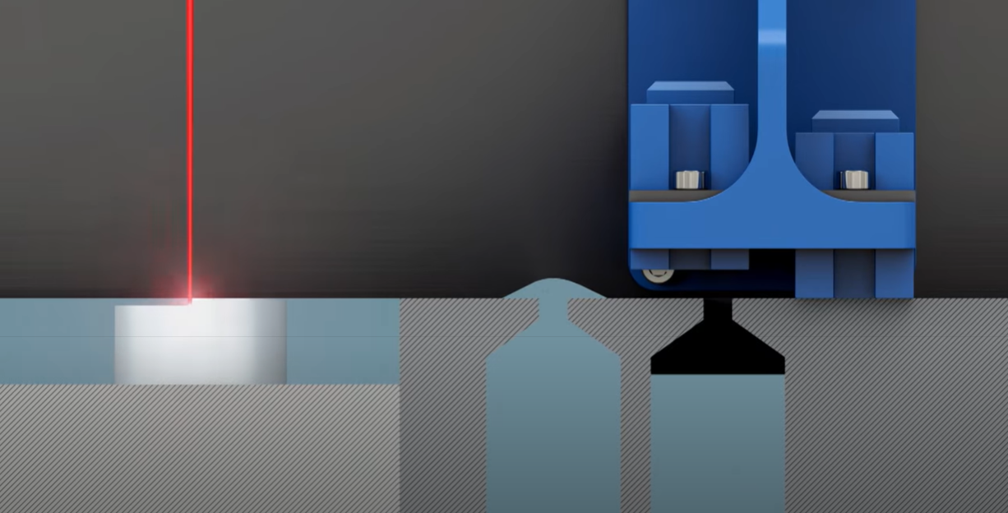
Background
1. 3D Printing/ Additive manufacturing, AM
Manufacturing technique which manufactures a product in a layer wise additive manner.
Advantages: Unprecedented design freedom and less material wastage
2. Laser Powder Bed Fusion, LPBF
Laser scans in a predefined path on a platform with uniformly spread metallic powder.
Creates a localised region below the laser beam known as melt pool.
Actively melts and fuses the metallic powder.
Laser Beam
Scan Direction
Powder
Melt pool
Figure 1 LPBF printing process

Slide 3
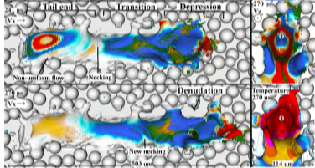
Background
3. Defects Formation
There will always be defects in the product. Some defects are tolerable, some are not.
Optimising scan parameters alone is insufficient – In-situ monitoring.
Melt pool dynamics is related to defects formation.
Eg. Denuded zone forms when the surface tension of the melt flow
entrains nearby particles into the melt flow. Partially melted particles
then ejected as spatter particles.
Figure 2: [1] Melt pool regions and denudation
1. S.A. Khairallah et al. , Laser powder-bed fusion additive manufacturing: Physics of complex melt ﬂow and formation mechanisms of pores, spatter, and denudation zones, Acta Materialia 108 (2016) 36–45

Slide 4
Objectives
The project focuses extensively on analysing the melt pool dynamics through the lens of machine learning models. The main objectives are:
Explore different machine learning models capable of detecting and classifying anomalous melt pools under different scans.
Evaluate the machine learning models performance with multiple test data.

Slide 5
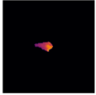
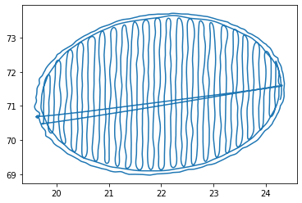
Datasets
Coaxial LPBF monitoring system which resolves the temperature field of the melt pool both in time and space
Video frames of resolved melt pools
Positional Dataset: x and y coordinates of the scan path
Melt pool video frame (128 x 128)
Positional Dataset

Slide 6
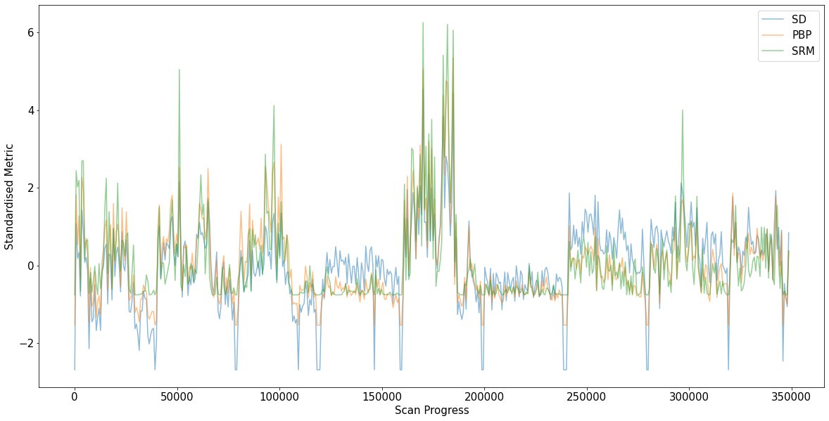
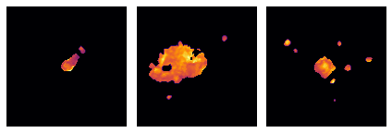
Exploratory Data Analysis
Metrics for visualisation
Standard Deviation: SD
Proportion of Bright Pixels: PBP
Subregion Mean: SRM
Block 4
Block 6
(a)
(b)
(c)
Figure 4: Standardised Metrics against melt pools’ frame ID.
Block 4 focus height = 4 mm
Block 6 focus height = 0 mm
Figure 3: (a) Tail Separation (b) Plume (c) Spattering

Slide 7
Region Props Features Extraction
Python’s Skimage Region Props function for features extraction:
Region Props Features
1. Melt pool
Size
Eccentricity
2. Spatter particle
Quantity
Average size
Average eccentricity

Slide 8
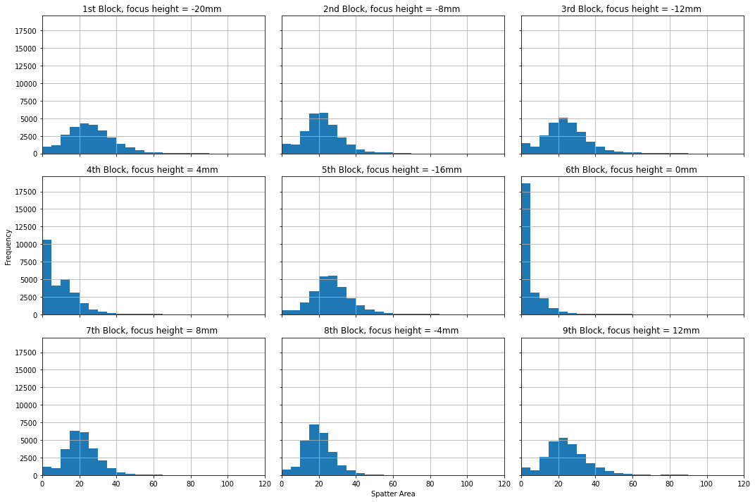
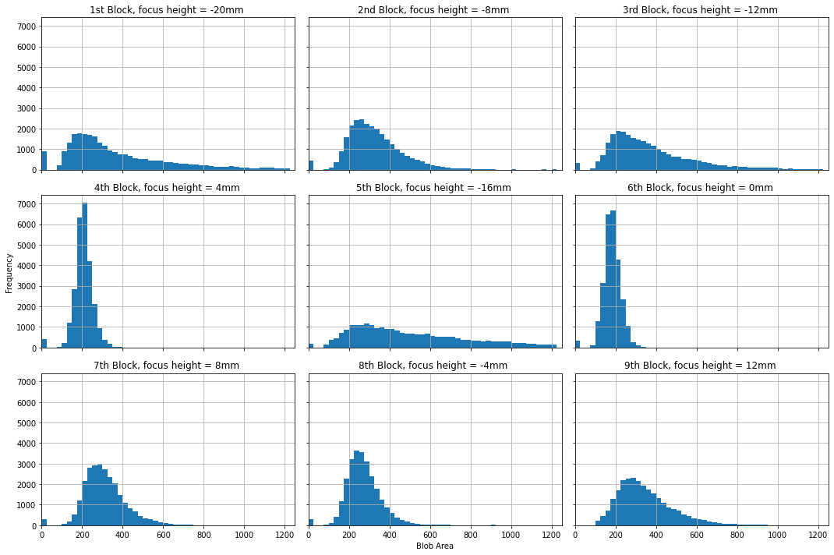
Features Extraction
Block 4
Block 6
Block 4
Block 6
Average spatter area
Melt pool size

Slide 9
Machine Learning Frameworks

Slide 10
One Class Learning Framework
Unsupervised method of training machine learning classifiers when some classes in the dataset are either present in a small amount, or have no well-defined characteristics.
One class classifiers are models which specialised in recognising the normal instances.
Anomalous melt pools are not necessarily the minorities, but they are not very well-characterised.
Eg. How many spatter particles a melt pool must eject and how big must they be for the melt pool to be considered as an anomalous instance?
Deep convolutional autoencoder used as one class classifier.

Slide 11
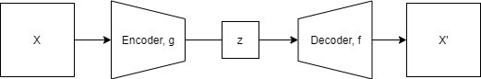
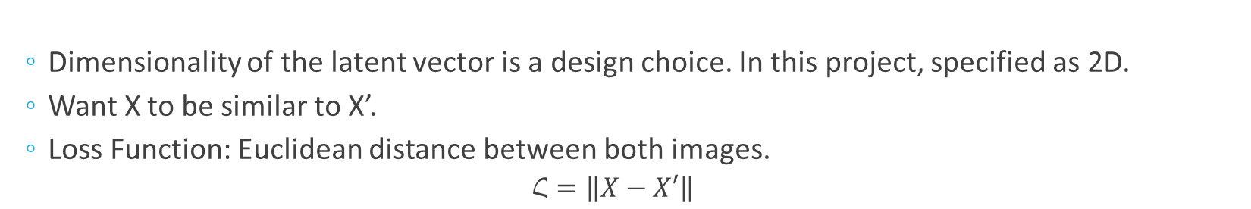
Autoencoder: Introduction
(Input Image)
(Output Image)
Latent vector
(Bottleneck)
General architecture of an autoencoder.
Dimensionality of the latent vector is a design choice. In this project, specified as 2D.
Want X to be similar to X’.
Loss Function: Euclidean distance between both images.
$$Հ=\left\|X−X′\right\|$$

Slide 12
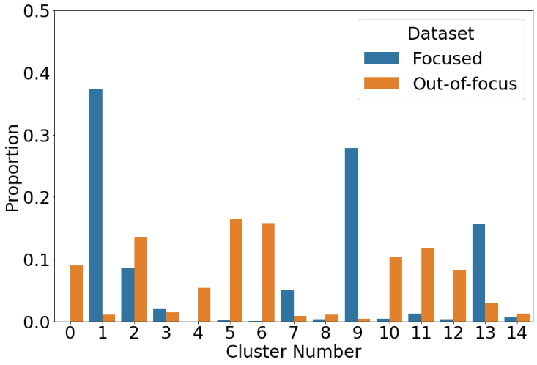
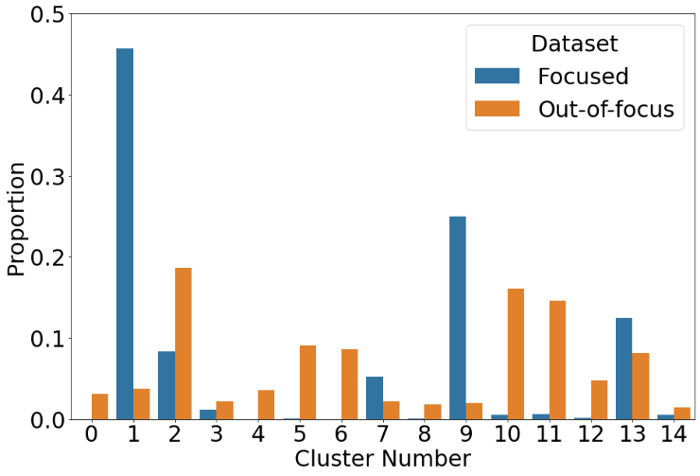
Data Pre-sieving
Constraint: Training dataset must contain mostly normal melt pool images.
For convenience, label melt pool frames as follow
Standardise the features and apply K-means Clustering and analyse the proportion of melt pool images in each cluster.
Table 1: Labelling of the dataset
Focused | Out-of-focus
Focus height = 0, +4mm | Focus height = -4mm, +8mm
“focused” melt pool images ( ) as training data.
Build 2 Data
Build 3 Data

Slide 13
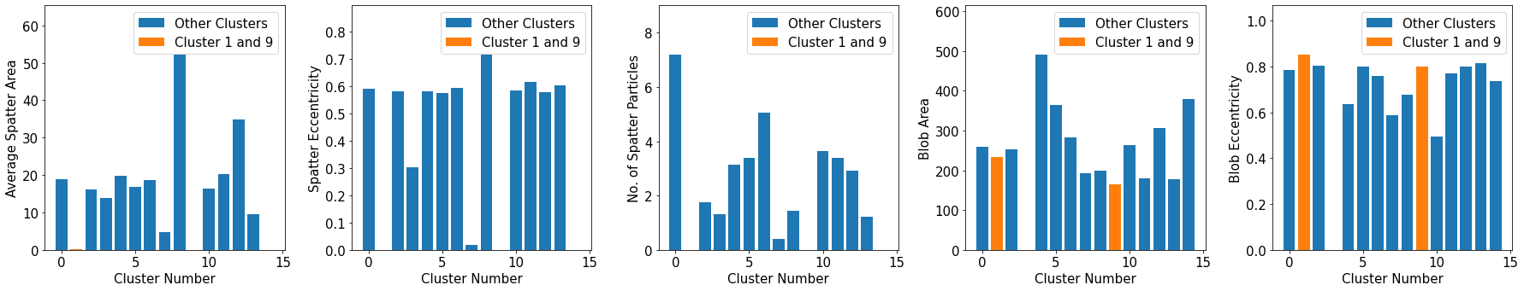
Clusters Analysis
Take the centroid coordinates of the clusters and show them in bar plots.
Average Spatter
Area
Average Spatter
Eccentricity
Number of spatter particles
Melt Pool
Blob Area
Melt Pool Eccentricity
Zero spatter properties
Similar melt pool properties

Slide 14
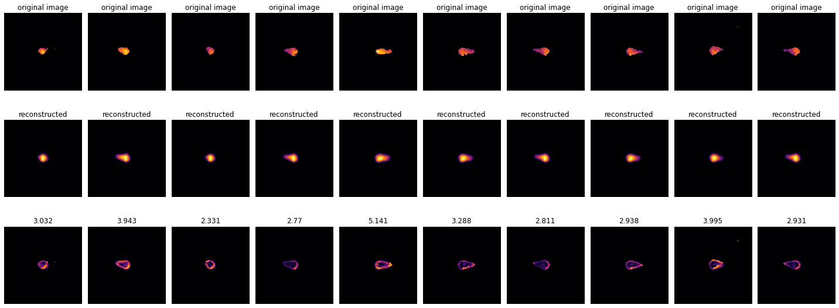
Autoencoder: Testing
Small Reconstruction error

Slide 15
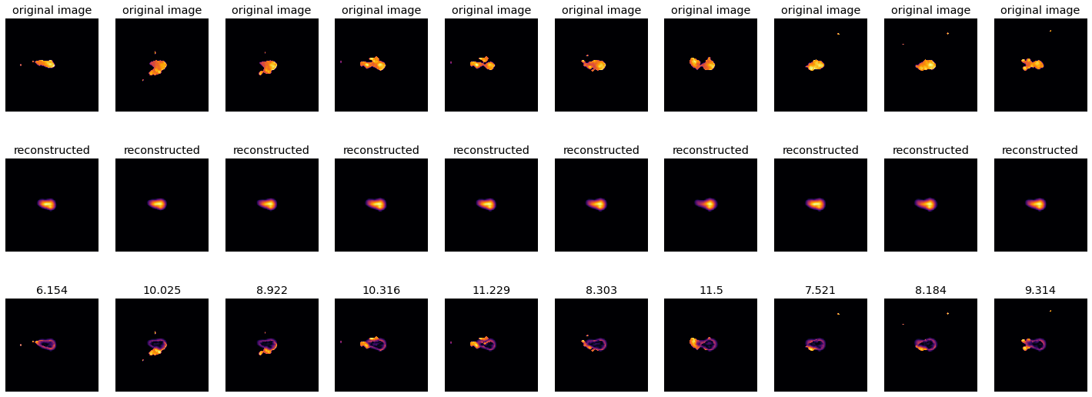
Autoencoder: Testing
Large Reconstruction error

Slide 16
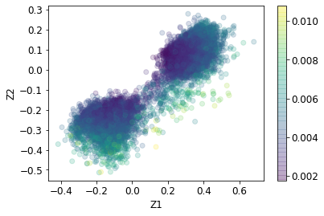
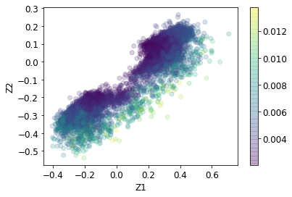
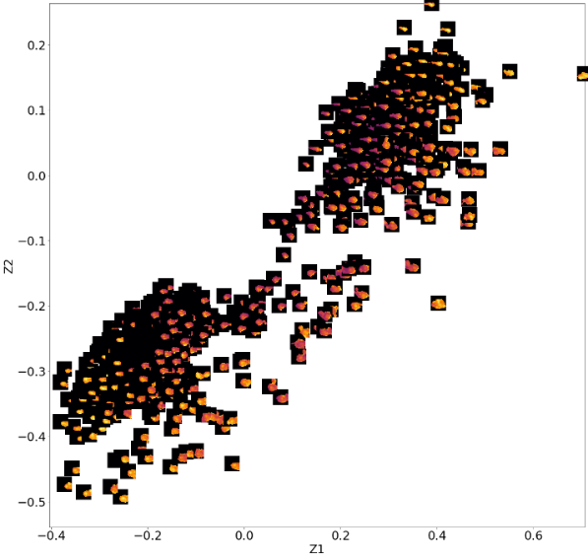
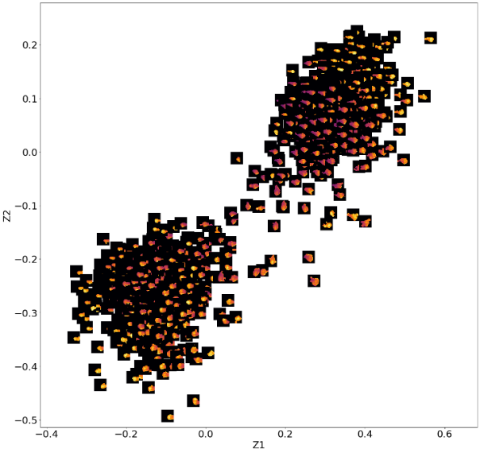
Training Data
Testing Data
Training Data
Testing Data

Slide 17
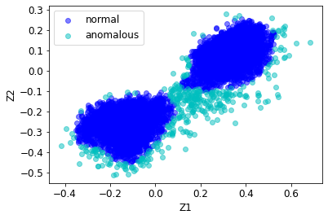
DBSCAN
Further cleaning with density based clustering algorithm, DBSCAN:

Slide 18
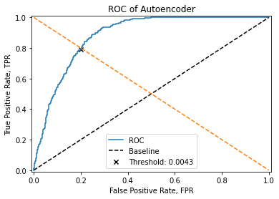
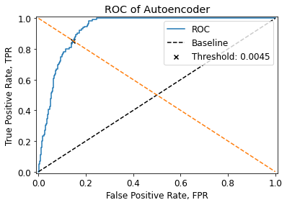
Performance Evaluation
Manually labelled 1500 datapoints for validation and testing. Classify the data into “Normal” and “Anomalous”.
Autoencoder
Autoencoder trained on DBSCAN

Slide 19
Performance Evaluation
 | Categories | Avg. Recall | Avg. Precision
K-Means Clustering | Normal | 0.89 | 0.54
 | Anomalous | 0.29 | 0.73
Autoencoder without DBSCAN | Normal | 0.71 | 0.96
 | Anomalous | 0.75 | 0.60
Autoencoder with DBSCAN | Normal | 0.76 | 0.96
 | Anomalous | 0.76 | 0.71
Autoencoder > K-Means
Autoencoder slightly improve its performance with DBSCAN

Slide 20
Automated Features Extraction Framework
Motivated by the data compression capability of the autoencoder.
But the latent space of an autoencoder is not smooth (highly packed in one region). Possible to address this with a probabilistic variant of an autoencoder, variational autoencoder (VAE).
The distributions of melt pool geometries -> smoother latent encodings.

Slide 21
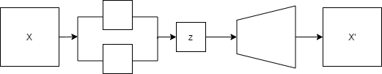
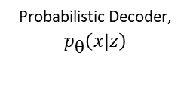
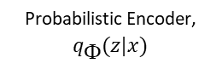
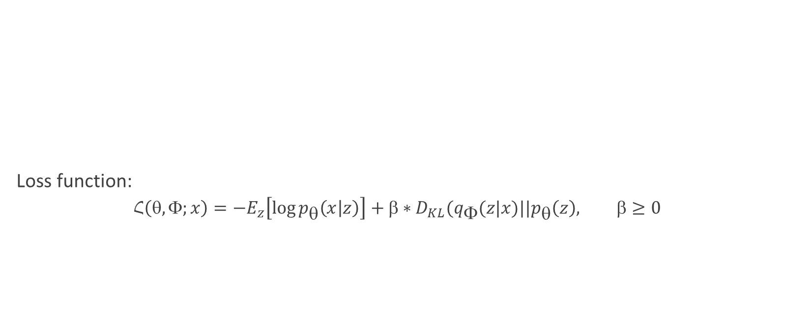
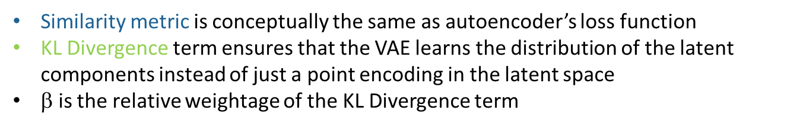
Disentangled Variational Autoencoder
Loss function:
$$Հ\left(, ;x\right)=−E_{z}\left[\log{p_{}\left(x | z\right)}\right]+∗D_{KL}(q_{}(z|x)||p_{}\left(z\right), ≥0$$
µ
σ
Probabilistic Encoder, $q_{}(z|x)$
Probabilistic Decoder, $p_{}\left(x | z\right)$
Similarity metric
KL Divergence
Similarity metric is conceptually the same as autoencoder’s loss function
KL Divergence term ensures that the VAE learns the distribution of the latent components instead of just a point encoding in the latent space
$$ is the relative weightage of the KL Divergence term

Slide 22
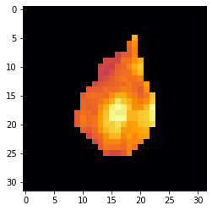
Image Cropping
Expand 16 px in each direction
Results in 32x32 cropped image
Centroid
Expand 16 px in each direction

Slide 23
Disentangled Variational Autoencoder
Specified the latent dimension as 3D for easy visualisation.
Specified a range for each latent components and pass it to the probabilistic decoder to inspect the melt pool representations captured.
Show the generated images in grid view.

Slide 24
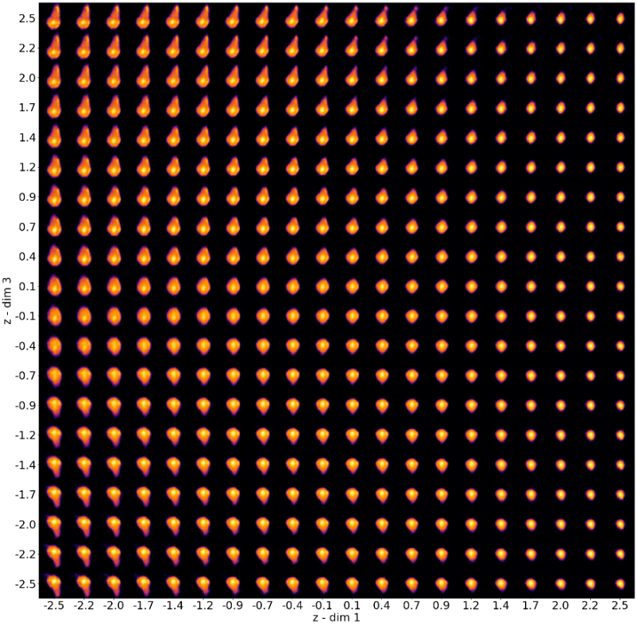
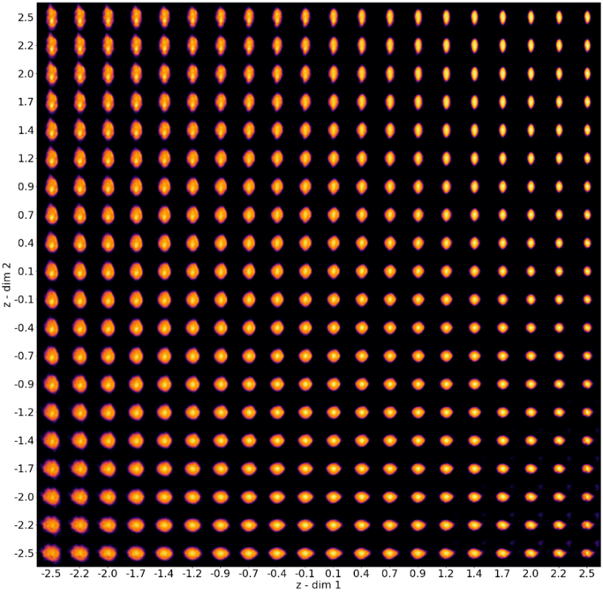
Tail Length & Direction (Z3)
Roundness (Z2)
Size (Z1)
Size (Z1)

Slide 25
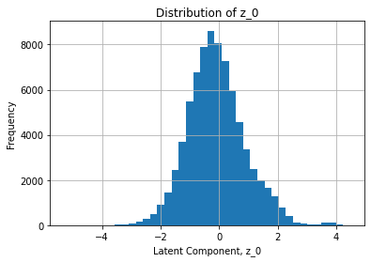
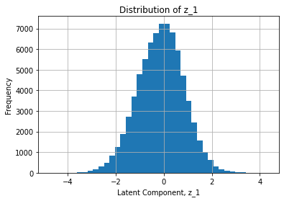
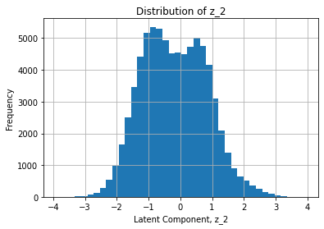
Automated Features Extraction Framework
Meander scanning, hence makes sense to be bimodal.
Z1
Z2
Z3
(a)
(b)
(c)
The distributions of latent components (a) Z1, (b) Z2 and (c) Z3.
Z1: Size, Z2: Roundness, Z3: Direction and tail length

Slide 26
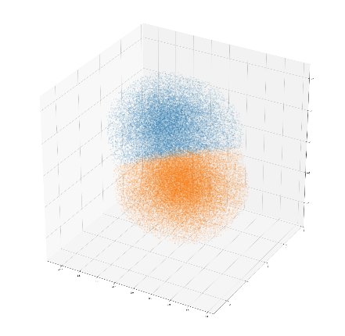
Anomalies Detection and Classification
Z3
Z2
Z1
K-Means Clustering fitted on training data then deploy for testing
Number of clusters specified as two. Makes sense to compare melt pools heading in the same direction.
Euclidean distance from the clusters centroid as anomaly metric.

Slide 27
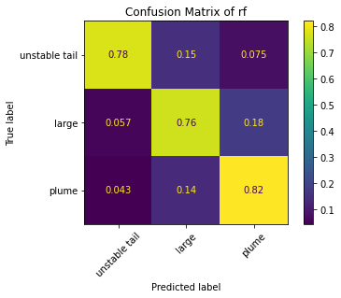
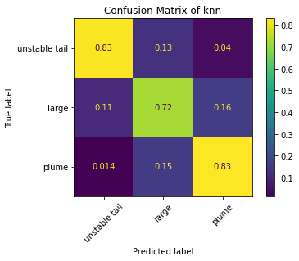
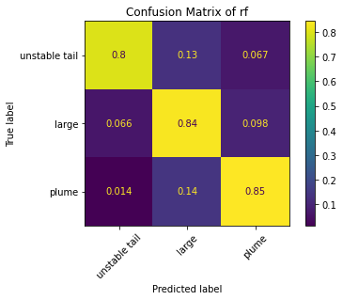
Anomalies Classification
Three supervised classifiers were trained: Random forest (RF), support vector machine(SVM) and k-nearest neighbours (KNN).
Classification performance: (The recall metric generally ranges in between 70% to 80%)
Confusion Matrix for Build 2 data classifications results. Focus height = +4mm (a)SVM, (b)KNN and (c)RF.

Slide 28
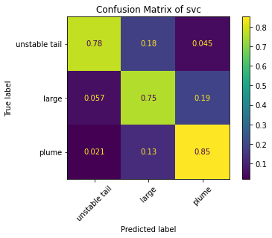
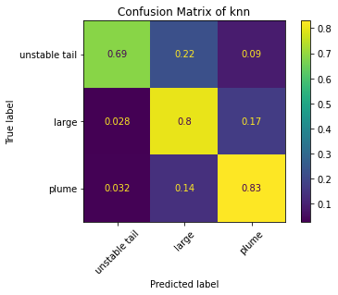
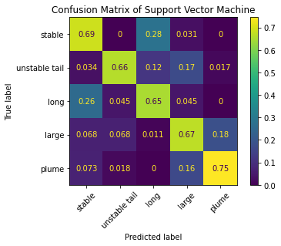
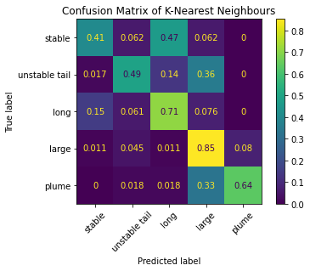
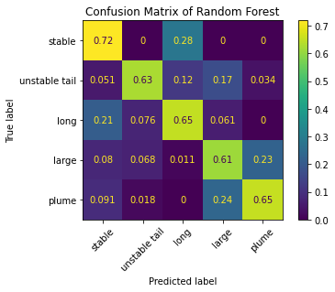
(a)
(b)
(c)
Confusion Matrix for Build 2 data classifications results. Focus height = -4mm (a)SVM, (b)KNN and (c)RF.
(a)
(b)
(c)
Confusion Matrix for Build 3 data classifications results. Focus height = 0mm (a)SVM, (b)KNN and (c)RF.

Slide 29
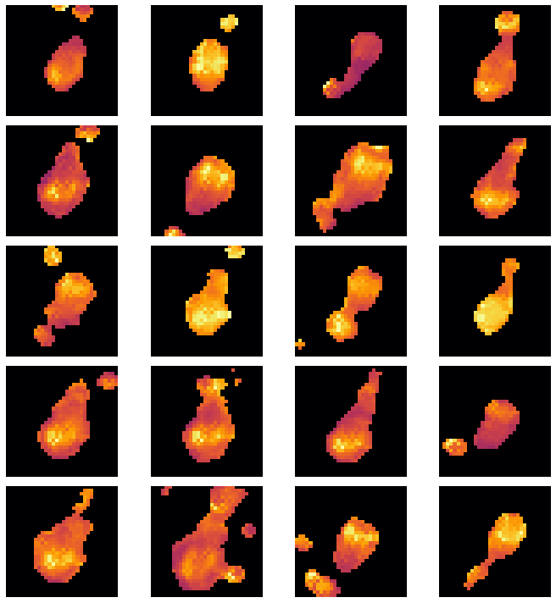
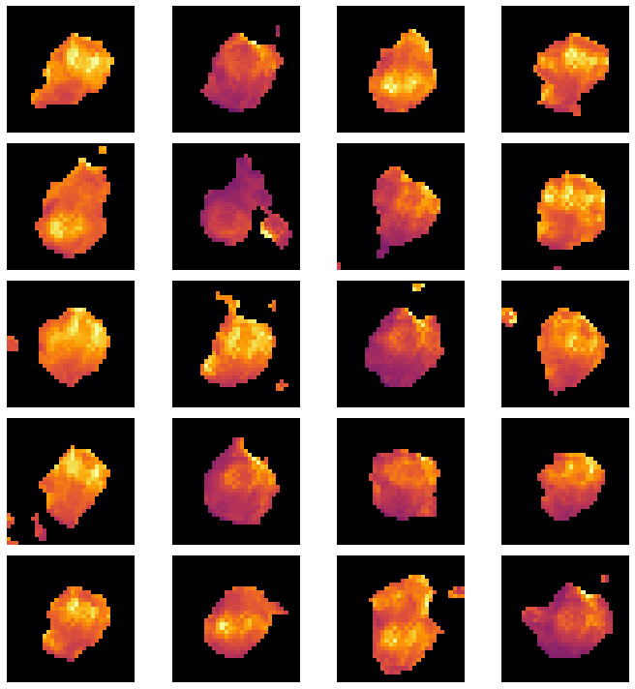
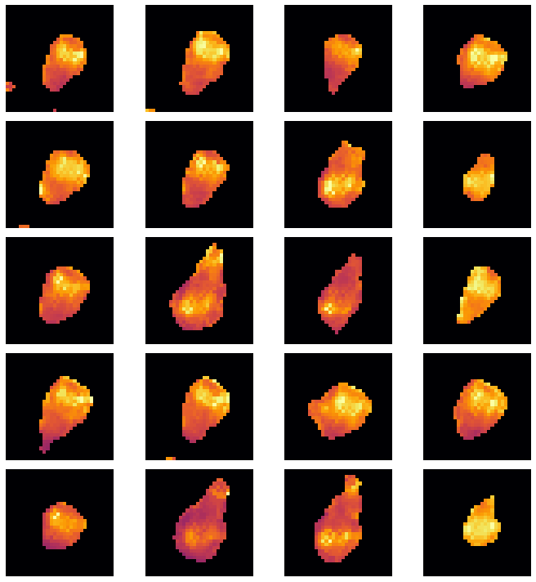
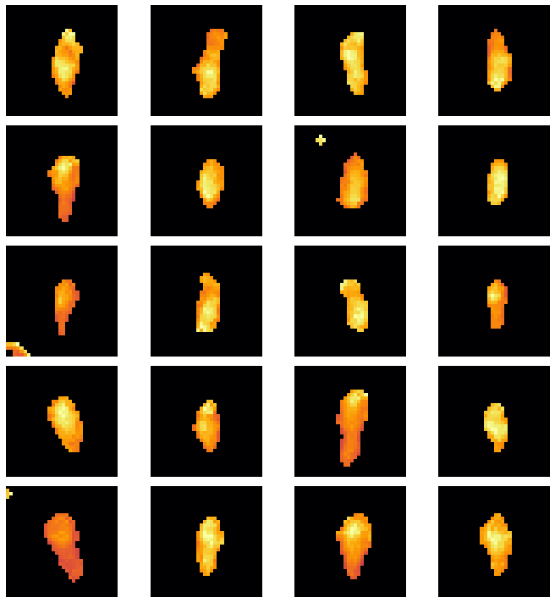
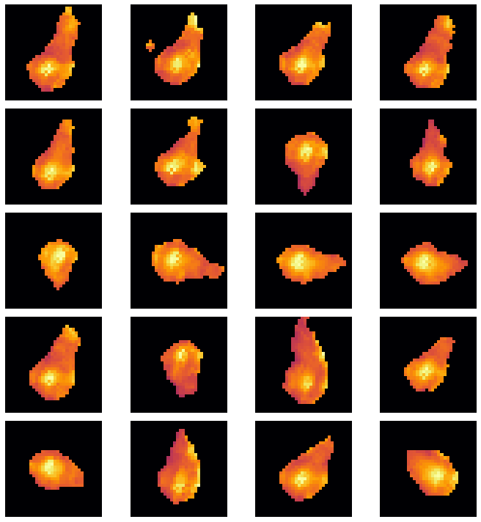
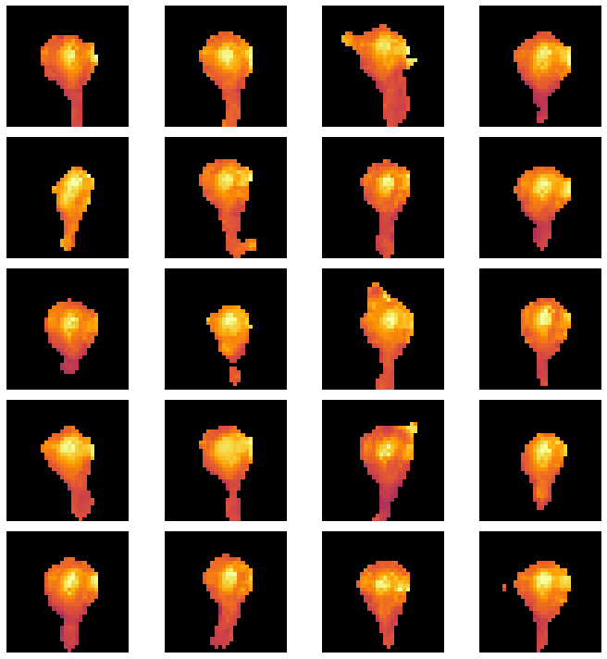
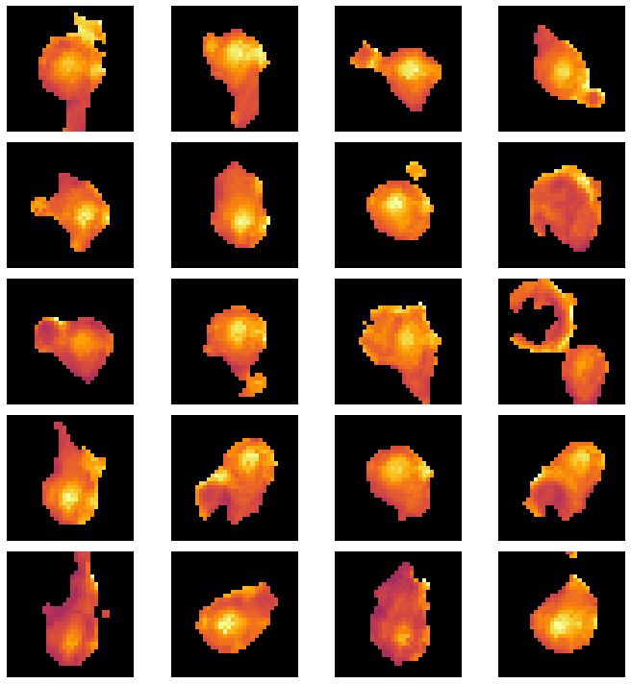
(a)
(b)
(c)
Build 2 Correct Classifications (a) Unstable Tail, (b) Plume and (c) Large melt pools.
(a)
(b)
(c)
(d)
Build 3 correct classifications. (a) Long, (b) Large, (c) Unstable tail and (d) Plume.

Slide 30
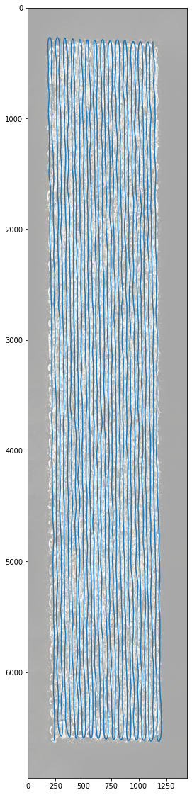
Case Study: Relating Melt Pool Anomalies to Defects
Overlay the positional data on a microscopic image of a
printed rectangular block.
Aim: Inspect anomaly metrics at various locations of defects.
Developed an interactive tool for inspection.
Caveat: Dark patches shown could be the shadowing effects and not
actual defects.
(a)
(b)
(a) Positional data overlaid on microscopic image (b) Original microscopic image

Slide 31


1
3
7
10
Variation of averaged anomaly metrics within the specified radius.

Slide 32


1st Selection:
Plume
3rd Selection:
Plume

Slide 33


7th Selection:
Unstable Tail
10th Selection:
Unstable Tail

Slide 34
3
7
10
Variation of averaged anomaly metrics within the specified radius.

Slide 35
Conclusion
Proposed two frameworks for melt pool anomalies detection and classification:
One class learning with deep convolutional autoencoder (Metric: Reconstruction error)
Disentangled Variational Autoencoder for automatic features extraction (Metric: Distance from respective centroids)
Classifications: Unstable tail, Large Melt Pools, Plume, Long Melt Pools
Future work will include more variations of melt pools for the training of disentangled VAE.

Slide 36
The End

